Slide 1
Thinking Straight: The Psychological qualities required by top class performers and how coaches can help develop them
Dave Rotheram
Rugby Football League
National Player Development Manager

Slide 2
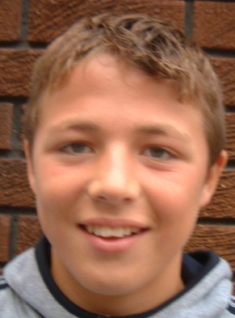
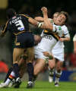
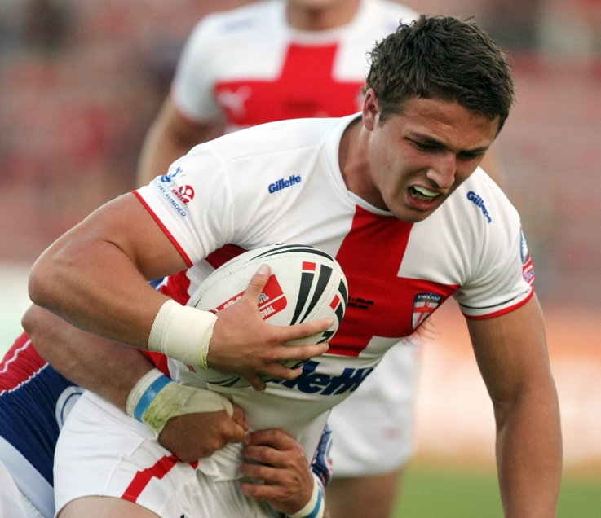
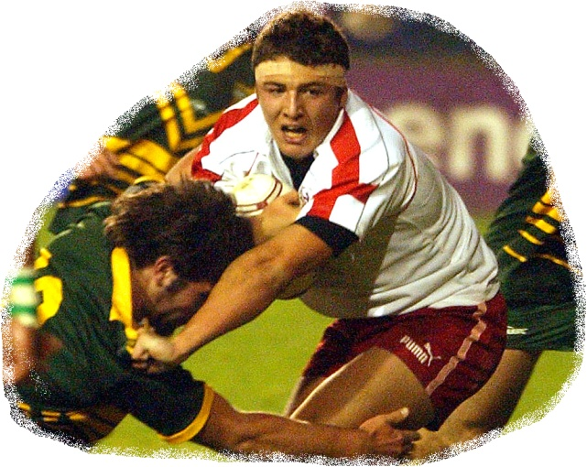
HOW DO YOU START WITH THIS?
AND TURN HIM INTO THIS?

Slide 3
GOING FOR GOLD
2012 clip.wmv

Slide 4
SOME TALENT DEVELOPMENT SYSTEMS

Slide 5
10 Years or 10,000 Hours
Ericsson 1996

Slide 6
Romance Phase Precision Phase Integration Phase
Ericcson, Krampe & Tesch-Romer 1993

Slide 7
Long Term Athlete Development (LTAD) Late Specialisation model (team sports)
Fundamental
Learning to train
Training to train
Training to compete
Training to win
Retirement & Retraining

Slide 8
Long Term Athlete Development (LTAD) Early Specialisation model (gymnastics)
Training to train
Training to compete
Training to win
Retirement & Retraining

Slide 9
Gearing up for Performance (Balyi, 2004: Based upon Wenger, 2000)

Slide 10
WHAT DOES AN ELITE PLAYER LOOK LIKE?

Slide 11
RUGBY LEAGUE PLAYER DEVELOPMENT FRAMEWORK
Technical
Tactical
Movement Skills
Athletic Development
Lifestyle
Psychological Development

Slide 12
As a coach, how much time do we spend on each of the 6 areas?

Slide 13
DEVELOPING PSYCHOLOGICAL QUALITIES
How to apply in ALL environments

Slide 14
SUPER LEAGUE & INTERNATIONAL COACHES
Attitude
Desire / Hungry
Self Belief / Confidence / Ego
Commitment
Consistency
Athletic Prowess
Mental Toughness
Technical Ability/Vision
Looking for the Challenge / Enthusiasm
Hard Work / Sacrifices
National Development Camp, 2008

Slide 15
Coach Perspective of Higher Performance in Youth Players
RANK | PERFORMANCE INDICATOR
1 | Discipline (set goals, preparation)
2 | Attitude (on/off field)
3 | Character outside football (school, job, family)
4 | Learning Ability
5 | Personality (coachability)
6 | Skill level
7 | Ability to fit in at the club
8 | Football ability (tactical awareness)
9 | Body Shape (applying it, future growth)
10 | Speed
Adapted from Cupples & O’Connor (2011), NYC Under 20 Coaches

Slide 16
“Cognitive indicators such as attitude, discipline, character, personality and learning ability were specified as crucial to reach the elite level. These identified factors reinforce the notion that physical talent alone does not guarantee success and that cognitive abilities influence the players “who get there”
Cupples & O’Connor (2011)

Slide 17
“DEVELOPMENT” COACHES QUOTES
“There’s a belief where you’ve either got it or you haven’t mentally instead of an understanding that mental skills can be trained like physical skills.”
“You can’t change your genetics, but you could change somebody’s attitude.”
“It’s important to start the psychological stuff fairly young. But I’m not sure that that psychological stuff needs to be “lie on my couch” stuff, it’s more practical psychology.”
Martindale et al, 2007

Slide 18
PSYCHOLOGICAL QUALITIES
Gould, Diffenbach & Moffett (2002)
Studied the Talent development of 10 USA Olympians, especially their psychological development

Slide 19
CHAMPIONS CHARACTERISED BY
Cope with and control anxiety
Show self confidence
Exhibit “mental toughness”
Block out distractions
Competitiveness
Strong work ethic
Set and achieve goals
Coachability

Slide 20
“Hence, they seemed to have developed mental skills that would prepare them for the long and difficult process necessary for developing their talent.”
Gould, D., Dieffenbach, K. & Moffett, A. 2002, ‘Psychological characteristics and their development in Olympic champions’, Journal of Applied Sport Psychology, n.14, pp.172-204.

Slide 21
CRUCIAL FOR EXCELLENCE
Effective and Controllable Imagery
Focus & Distraction Control
Realistic Performance Evaluation & Attribution
Role Clarity & Commitment
Planning & Organisation
Goal Setting & Self-reinforcement
Quality Practice
Collins (2009)

Slide 22
APPLICATION IN YOUR COACHING

Slide 23
THE CHANCES ARE YOU’RE ALREADY DOING THIS!!

Slide 24
Commitment
Effective & Controllable Imagery
Focus & Distraction Control
Realistic Performance Evaluation & Attribution
Role Clarity
Planning & Organisation
Perceptions of Pressure
Goal Setting & Self-reinforcement
Quality Practice

Slide 25
COMMITMENT
PROMOTING | SYSTEM | COACH BEHAVIOUR | INSIGHTS
Players Attend regularly and communicate absences in advance of the session. | Clear and communicated expectations for attendance and who to contact. | Communicate expectations in advance Provide contact details and appropriate method for communicating Acknowledge absences (players/staff) to the group Keep a register of attendance | Agree a process for non adherence of agreed expectations

Slide 26
EFFECTIVE CONTROLABLE IMAGERY
PROMOTING | SYSTEM | COACH BEHAVIOUR | INSIGHTS
When practicing a skill player’s mentally rehearse the skill before trying the skill. | Raise awareness of the importance of imagery in improving a player’s game. | Discrete activities set to encourage imagery Use questioning which encourages the players to recall and use imagery Provide high quality demonstrations (coach, player & video) Regular opportunities to experience imagery in sessions and through individual challenges | Use questioning (how did that feel, what did you see/what did it look like, what did you hear) Use of role model footage

Slide 27
PLANNING AND ORGANISATION
PROMOTING | SYSTEM | COACH BEHAVIOUR | INSIGHTS
Players to consider their weekly routine around their game preparation. | Reinforce the importance of having an established routine for game preparation. | Provide examples of a weekly routine gradually increasing the commitment and consistency i.e. rest, recovery, nutrition, hydration and lifestyle choices Highlight good practice and use role model examples Acknowledge and accept ‘hot spots’ Demonstrate a wider interest in the players lives | Role model the behaviours expected as the coach Communicate ‘hot spots’ in the schedule

Slide 28
A 12 YEAR OLD.......
I joined the swimming club… On the first day of swim practice, I was so inept I was put with the seven-year-olds. I looked around and saw the youngest sister of one of my friends. It was embarrassing.
But I tried. If I had to swim the little kids to learn technique, then that’s what I was willing to do. My mother gets emotional to this day when she remembers how I leaped headfirst in the water and flailed up and down the length of the pool, as if I was trying to splash all the water out of it. “You tried so hard,” she says. I didn’t swim in the worst group for long. Within a year, … I was fourth in the state in the 1,500-meter freestyle.

Slide 29
LANCE ARMSTRONG

Slide 30
AND A 10 YEAR OLD......
“At ten years old I was the youngest and was a bit too small for the boat. …. I was frustrated when I came last or second last in most races as I imagined I would be able to get better results.
On the journey home I decided I would never let this happen again. I wasn’t going to be last, no matter what it took.”

Slide 31
ELLEN McARTHUR

Slide 32
REFERENCES
Cupples B & O’Connor D (2011), The Development of Position-Specific Performance Indicators in Elite Youth Rugby League: A Coach’s Perspective
Gould D & Carson S (2004), Myths surrounding the role of youth sports in developing Olympic champions
Collins D (2009), Talent ID and Profiling
Martindale et al (2007), Effective Talent Development: The Elite Coach Perspective in UK Sport

